Slide 1

ENG0001E: Engineering Management - Level 2
Module 09: Engineering Contractor ‘s Document Preparation & Issue

Slide 2
Engineering Contractor’s Document Preparation & Issue
Engineering and design documents will be developed by the Licensors and DECs (DEC). Design document deliverables developed by the Licensors and DECs will include the following:
Drawings
Specifications
Calculations
Reports and Studies
The PMT will review and monitor the development of Engineering and Design documents produced by the Licensors and DECs via the participation in Reviews and Audits together with formal reviews of documents and drawings submitted to the PMT throughout the life of the project.

Slide 3
Drawings
Specific drawing requirements for the project are described in the PDS/CAD Procedures Manual. Key issues regarding drawing production by Licensors and DEC include:
Design drawings will utilize computer aided design and drafting as described in Project Information Management section.
Drawings for reports / studies will be A4 or A3 sized sheets, while P&IDs, flow diagrams, construction drawings, etc. will generally be A1 sized.
The J3 Program specific title block will be issued to all DECs for use.
J3 Program specific drawing numbering system will be used by all DECs and is defined in the PCPM.
Original, signed drawings will be retained by the Licensor and DECs Project Document and Data Management (PDDM) group for issue and file retention in line with their internal procedures.
Drawings will be Reviewed and Approved in line with the requirements set out in the TRAM and is detailed in the PCPM.
Project deliverables developed by the Licensors and DECs will be Reviewed and Approved in line with the requirements set out in the Technical Review and Approval Matrix (TRAM) issued for the J3 Program.

Slide 4
Drawings
The two main types of engineering drawings include:
Design basis
Production drawings
Key Steps:
1
PMT CAD Coord
2
DEC Discipline Lead
3
DEC Engineer / Design
4
DEC Engineer / Design
Establish a
Assign unique
Prepare drawings and
Name electronic files
In consistent manner
Ensure drawings
standard drawing
number to each
contain a unique
format
drawing per standard
revision number
5
DEC Engineer / Design
6
DEC Discipline Lead
7
DEC Disc Lead / Doc Ctrl
8
DEC Engineer / Design
Perform required
Obtain required
Issue drawings and
Revise drawings
checks and
approvals
maintain originals in
if required
reviews
project files

Slide 5
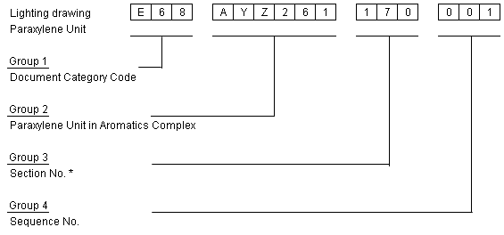
Drawing Numbering
The numbering scheme has been picked up from Project Coordination Procedure for J3-PCP-08-005-00 Drawing and Document Numbering System.
Example:
Group 1: Document Category Code normally has three characters. The three-character identifier is made up of the discipline code letter and two digits that define the drawing type.
Group 2: Project/Complex/Unit identifier and it is a six digit alphanumeric code. (Refer to the Project WBS). E.g. AYZ261 (Paraxylene Unit in Aromatics Complex)
Group 3: Section Number, (This is an Optional field), Contractor to include an additional section number where the Work Breakdown Structure (WBS) does not provide sufficient granularity to fit their work processes.
Group 4: Drawing sequence number and it is numbered sequentially from 001.

Slide 6
Drawings – Key Points
Detailed practices to control development
Numbering convention communicated to project team:
Engineering Contractor’s standard format or,
J3 -specific format
DEC Discipline Leads assign and coordinate numbering
Procedures define requirements for review and approval

Slide 7
Technical Review and Approval Matrix - TRAM

Slide 8
DOR-Division of Responsibility Matrix
Sr No | Deliverable / Activity Description | X - Full Responsibility / Final Doc Release |  |  | Note : The activity shown under TPI/TCM/TICB is to be read in conjunction with commercial terms for execution for chargeable/lum-sum basis.
 |  | X1 - Prelim Resp / Base doc / Input / Participate
 |  | A - Review & Approve
 |  | R - Review & Comment
 |  | LICENSOR | EP CONTRACTOR |  | PMC | RIL
 |  |  | Basic engg. scope | Detail engg scope
 |  |  | TPI | TPI
1.5 | PIPING AND INSTRUMENTATION DIAGRAM (P&ID)
1.5.1 | PIDs shall contain following information
 | All equipment including spare equipment
 | All process piping lines with sizes
 | Utility lead lines & Line specifications
 | Service codes or symbols
 | Valves, Relief System requirements
 | Major relief valves with set pressure
 | Piping interconnections for drains
1.5.2 | Issue PIDs for Approval
 | PDP Section | X | R | R |  | A
 | Non PDP Section |  | R | R |  | A
1.6 | PIPING LINE LIST (LINE DESIGNATED TABLES)
 | PDP Section, Non PDP Section | X1 | R |  |  | R
1.6.2 | Periodically Issue LDT in agreeed format as editable copy |  |  |  |  | R

Slide 9
Specifications
Specification for use on the J3 program will be developed and issued to all Licensors and DECs. These shall be maintained throughout the life of the project and update issued as required.
Where specifications are required by Licensors and/or DECs that do not exist within the standard specifications issued for the Program these shall be developed by the DEC and issued to the PMT/Reliance for Reviewed and Approved in line with the requirements set out in the TRAM.
In case of conflict between this document and other project specific standards / specifications, the matter shall be referred to PMT / Reliance.
The order of precedence of documents to be used on this project is a follows:
Indian Government Statutory Rules and Regulations
Requisition Data Sheets
Requisition and Specifications
Any mandatory requirements set out by RIL in Project Procedures
International Codes and Standards

Slide 10
Specifications
Specifications will be produced using appropriate industry codes and standards, local (e.g. OISD etc) and J3 standards and will use J3 format. The specifications will be customized in order to provide equipment and materials with the required level of quality for the function the equipment is performing.
Specifications will be turned over to DCC for issue to Licensors and DECs and file retention.

Slide 11
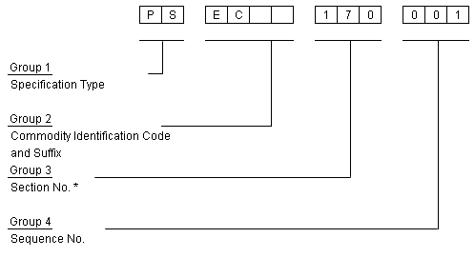
Specification Numbering
Group 1 | The specification type will be one of the following designators.
 | GU - Guideline.
 | SS - Standard Specifications.
 | PS - Project Specifications.
Group 2 | Commodity Identification code comprises of a Commodity Group code and Sequence Prefix if applicable and may be up to six characters (EC denotes Electrical)
Group 3. | Section Number, (This is an Optional field), Contractor to include an additional section number where the Work Breakdown Structure (WBS) does not provide sufficient granularity to fit their work processes.
Group 4 | This is the specification sequence number which begins at 001 for each commodity type.

Slide 12
Specifications
Describe equipment, materials, and construction methods for the project
Typically included in purchase orders / subcontracts
Key Steps:
1
PMT Leads
2
DEC Discipline Lead
3
DEC Engineers
4
DEC Engineers
Establish
Assign unique
Prepare Spec and
Name electronic files
In consistent manner
Ensure specs
specification
number to each spec
contain a unique
source and format
per standard
revision number
5
DEC Engineers
6
DEC Discipline Lead
7
DEC Disc Lead / Doc Ctrl
8
DEC Engineers
Perform required
Obtain required
Issue specs and
Revise
checks and
approvals
and record
maintain originals in
specifications
reviews
project files
if required

Slide 13
Specifications – Key Points
Project specific requirements
Specifications prepared by each discipline
Internal review and approval
Formal issue / distribution
PMT review and acceptance
Numbering system consistent with drawings

Slide 14
Calculations
Calculations will be prepared by Licensors and DECs as necessary to support the design. Analytical software programs, which are not already qualified by PMT/Reliance and have been used for calculations, will be subject to approval by PMT/Reliance.
Completed formal calculations developed by the DEC that support the final will be issued to the PMT/Reliance and will be Reviewed and Approved in line with the requirements set out in the TRAM.
Calculations will be turned over to PMT/Reliance for issue and file retention in line with requirements defined in the contract.

Slide 15
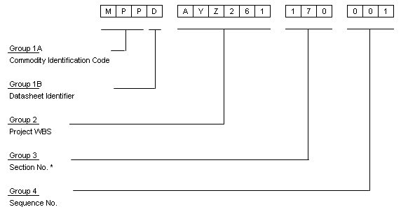
Calculation Numbering
Group 1A | Commodity Identification code comprises of a Commodity Group code and Sequence Prefix if applicable and may be up to six characters (MPP denotes pump)
Group 1B | Data Sheet Identifier. Always ‘D’ except for Process Data Sheet which shall be ‘’BD’
Group 2 | Project/Complex/Unit identifier and it is a six digit alphanumeric code. (Refer to the Project WBS).
Group 3. | Section Number, (This is an Optional field with the exception of Instrumentation), Contractor to include an additional section number where the Work Breakdown Structure (WBS) does not provide sufficient granularity to fit their work processes. Instrument Datasheets shall always have a six character number, if section number is not used zeros shall be inserted, no space or dash shall be inserted between the section and sequence number, (i.e, 170113 or 000113).
Group 4 | Data sheet sequence number commencing at 001.

Slide 16
Calculations
Calculations compiled to:
Form the basis of design
Maintain a record of the basis of design
Key Steps:
1
PMT Engineers
2
DEC Discipline Lead
3
DEC Engineers
4
DEC Engineers
3
DEC Engineers
Document basis
Assign unique
Prepare Calculation
And Name electronic
Files in consistent
manner
Ensure calculations
Ensure software is
and objective of
number to each
contain a unique
validated and
calculation
calculation
revision number
verified
5
DEC Engineers
6
DEC Engineers
7
DEC Disc Lead / Doc Ctrl
8
DEC Engineers
Perform required
Obtain required
Issue calculation if
Revise calculation
checks and
approvals
and record
needed and maintain
if required
reviews
originals in project files

Slide 17
Calculations – Key Points
Considerations:
Supplier data availability
Compliance with Engineering Contractor’s standard engineering practices
Limited in scope
Results from revised calculations must be shared
Validation of software / calculation processes
Calculations not normally issued to PMT

Slide 18
Engineering Study Reports
Licensors and DECs will perform studies and prepare reports as defined in the Scope of Work. These shall be issued to the PMT/Reliance Reviewed and Approved in line with the requirements set out in the TRAM.
Engineering studies will be prepared in a standard format established for the project.
Studies will be turned over to PMT/Reliance for issue and file retention.

Slide 19
Reports and Studies
Required for special needs such as:
Process / Utility studies
Environmental permit report
Key Steps:
1
PMT Leads
2
DEC Discipline Lead
3
DEC Engineers
4
DEC Engineers
Establish report /
Assign unique
Prepare Report and
Name electronic files
In consistent manner
Ensure reports /
study format
number to each
studies contain a
report / study
unique revision number
5
DEC Engineers
6
DEC Discipline Lead
7
DEC Disc Lead / Doc Ctrl
8
DEC Engineers
Perform required
Obtain required
Issue reports /studies
Revise reports /
checks and
approvals
and record
and maintain originals
studies
reviews
in project files
if required

Slide 20
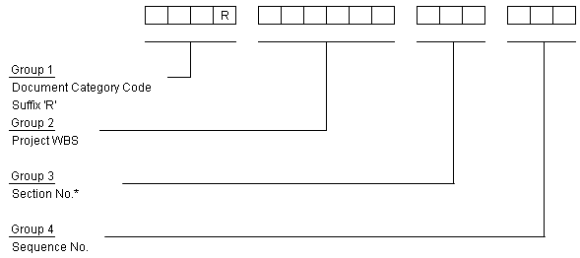
Study / Report Numbering
Group 1 | Document Category Code. and Report Identifier suffix ‘R’. Various documents produced by DEC shall indicate a code for type / category of drawings. This is required to suit the documentation system in Reliance so that the documents are stored category wise to enable easy and quick retrieval. For example G21 denotes Block Diagram.
Group 2 | Project/Complex/Unit identifier and it is a six digit alphanumeric code. (Refer to Project WBS).
Group 3. | Section Number, (This is an Optional field), Contractor to include an additional section number where the Work Breakdown Structure (WBS) does not provide sufficient granularity to fit their work processes.
Group 4 | Study Report Sequence Number commencing at 001.

Slide 21
Reports and Studies – Key Points
Engineering Contractor’s internal or RPMG deliverables
General reference software
Checks and reviews
Numbering system consistent with drawings
Supporting cost estimates

Slide 22
Other Deliverables
Other deliverables not falling into the categories listed above but required to support the development and construction of the J3 program and prepared by the Licensors and DECs shall be issued to the PMT/Reliance for review and approval in line with the requirements set out in the TRAM.

Slide 23
Wrap up
Mandatory bullet input from each group at the conclusion of each module
Highlights:
Pluses:
Deltas:
Proposed path forward for future:
Instructor shall compile a composite

